Slide 1
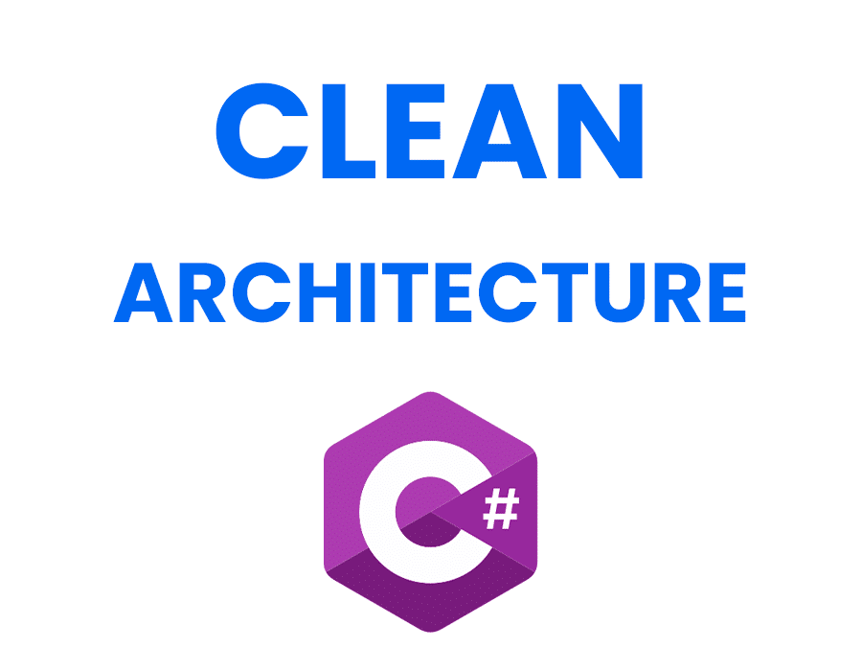
Skill National University
Minab Branch
Mohammad Ahmadzadeh

Slide 2
Clean Architecture :
It is a software design pattern that emphasizes a structured approach to organizing code, promoting separation of concerns, and ensuring that systems are flexible, maintainable, and testable. Developed by Robert C. Martin (often referred to as "Uncle Bob"), this architecture divides applications into distinct layers, each with specific responsibilities and dependencies.
Key Concepts of Clean Architecture
Layered Structure
Clean Architecture is often visualized as a series of concentric circles, where each layer has a specific role:
Entities: Represent the core business objects and rules. They encapsulate the fundamental logic of the application.
Use Cases: Define the application's specific business rules and interactions. This layer dictates what the application should do.
Interface Adapters: Include controllers and gateways that convert data between the format used by the use cases and the format required by external agents (like databases or web services).
Frameworks and Drivers: The outermost layer that contains details such as user interfaces, databases, and other external tools.

Slide 3
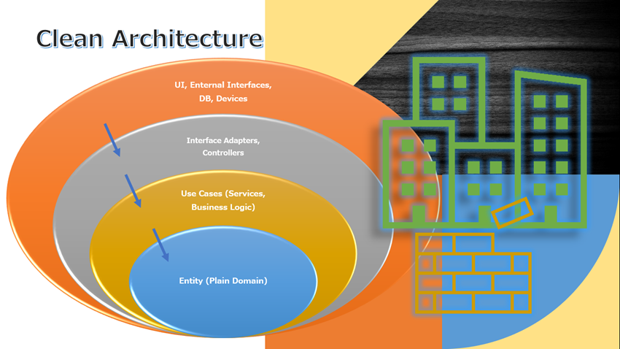

Slide 4
Principles of Clean Architecture
Separation of Concerns: Each layer has distinct responsibilities, which helps manage complexity.
Dependency Rule: Dependencies should only point inward; outer layers should not depend on inner layers.
Independence from Frameworks: The architecture does not rely on any specific frameworks or libraries, allowing for easier updates and changes.
Testability: The separation of business logic from external dependencies enhances the ability to write unit tests.
Benefits
Improved Testability: Business rules can be tested independently of UI or database concerns.
Flexibility: Changes in one part of the system can be made with minimal impact on others.
Maintainability: Clear separation makes it easier to understand and modify the codebase.
Reusability: Business logic can be reused across different projects or components.
Scalability: Facilitates scaling applications to handle increased load or new features without major redesigns.

Slide 5
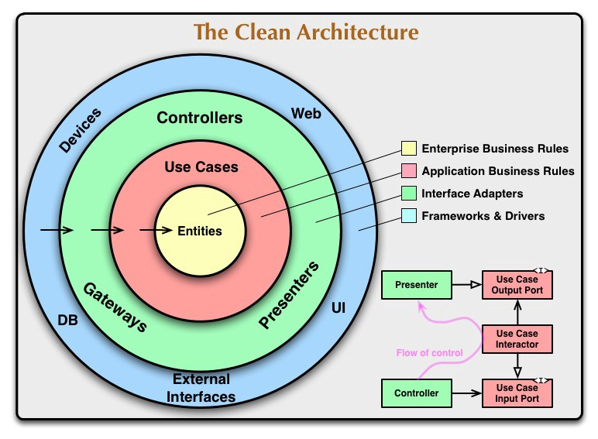

Slide 6
Here’s a typical folder structure for a C# project following Clean Architecture principles, based on the information gathered from various sources:
Summary of Layers
Domain Layer: Core business logic, entities, and domain-specific rules.
Application Layer: Use cases and application logic, including commands and queries.
Infrastructure Layer: Data access implementations and external service integrations.
Presentation Layer: Entry point for user interactions, typically through APIs.
This structure promotes separation of concerns, making the codebase more maintainable and testable while allowing for flexibility in changing technologies or frameworks without affecting the core business logic

Slide 7
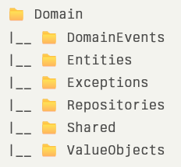
Clean Architecture Folder Structure
1. Domain Layer
This layer contains the core business logic and domain entities. It should not depend on any other layers.

Slide 8
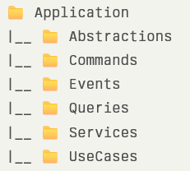
2. Application Layer
The application layer orchestrates the use cases and business logic. It typically includes services, commands, and queries.

Slide 9
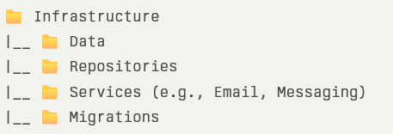
3. Infrastructure Layer
This layer handles external concerns such as data access, file systems, and network communications. It often contains implementations of interfaces defined in the application layer.

Slide 10
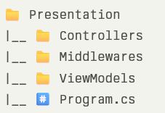
4. Presentation Layer
The presentation layer is where the API or user interface resides. This is typically implemented as a Web API project.

Slide 12
Conclusion
Clean Architecture provides a robust framework for developing software that is adaptable to change while maintaining high standards of quality and testability. Its emphasis on modularity and clear boundaries between components makes it a popular choice among developers looking to create scalable and maintainable systems

